Slide 1
Framework of Live Doubt Session
Session starts at 5:15 PM
Weekly recap of topics (via PPT)
Students may post doubts in the chat during the presentation
Topic-wise doubt clarification after the recap
Assignment-related doubts addressed at the end

Slide 2
Recap for Week 3
Convex vs non convex functions.
First Order and Second Order Characterization of Convexity
Positive definite and semi-definite matrices.
Hessian Shapes
Role of Convexity in optimisation.
Numerical schemes for unconstrained optimisation.
Line search
Gradient Descent Method with example.
Univariate Unconstrained , Multivariate Unconstrained Optimisations
Fermat’s Rule
Hessian Sufficiency (Diff from Hessian Matrix )

Slide 3
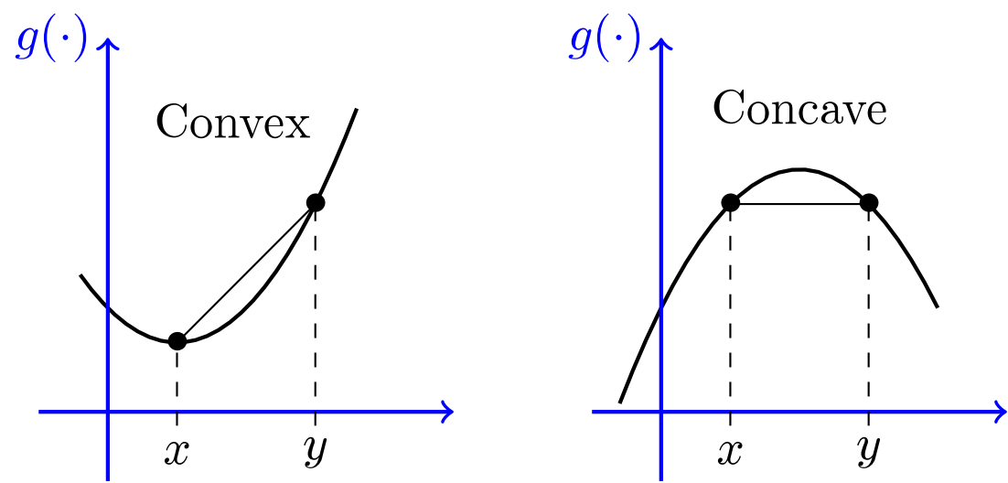
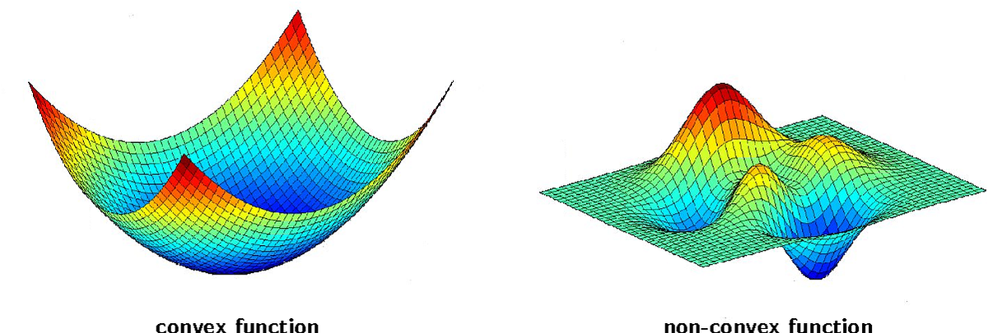
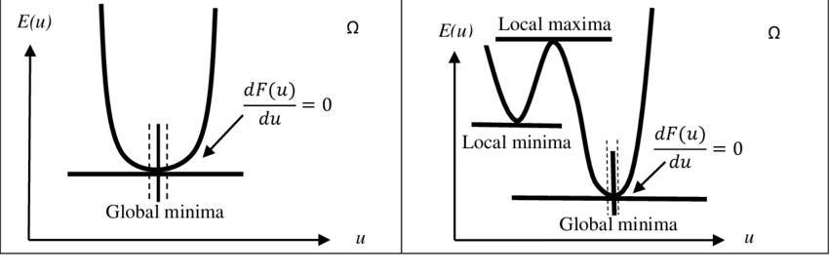
Convex vs Non-Convex Functions :-
Geometric Meaning of Convex - Only one global minimum
Real Life Example - Cost minimization in manufacturing ,
Linear regression loss function (MSE)
Non-Convex Function - Multiple local minima
Hard to find global minimum , Neural networks (deep learning) are non-convex
Real Life Example - Deep neural network training , Portfolio optimization with complex constraints

Slide 4
First Order Characterization of Convexity: - f(y) ≥ f(x) + ∇f(x) T(y−x) Meaning: Function always lies above its tangent plane.
Intuition: Gradient gives a supporting hyperplane.
Second Order Characterization of Convexity:- For twice differentiable function: ∇² f(x) ⪰ 0 ,→ Strictly convex.
(Hessian matrix is positive semi-definite (PSD)
Positive Definite & Semi-Definite Matrices :-
Positive Definite (PD):- X^{T}AX > 0 , X = Matrix , X^{T} = Transpose of Matrix
All eigenvalues > 0 , Surface shaped like bowl , Unique minimum
Positive Semi-Definite (PSD) :- X^{T}AX ≥ 0 , X = Matrix , X^{T} = Transpose of Matrix
Eigenvalues ≥ 0 , Flat directions possible
Real Example :- Covariance matrix in ML → Always PSD.

Slide 5
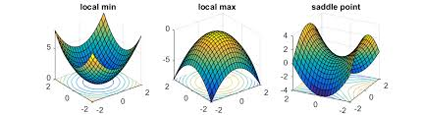
Hessian Shapes:
Fermat’s Rule: If x∗ is a local minimum and differentiable :- ∇f (x∗) = 0 , x∗ → Optimal solution
Important Condition : Gradient zero is necessary, not sufficient.
Hessian Sufficiency (How Hessian Sufficiency is Different from Hessian Matrix ?)
Hessian Matrix = Matrix of second derivatives.
Hessian Sufficiency = Condition using Hessian to classify stationary point.
If , ∇f(x∗)=0 Hessian PD → Local minimum Hessian ND → Local maximum Hessian indefinite → Saddle
Hessian Type | Shape | Conclusion
PD (Positive Definite) | Bowl | Local Minima
ND (Non Definite) | Upside Bowl | Local Maxima
Indefinite | Saddle | Saddle Point

Slide 6
Unconstrained Optimization:-
Univariate (Single Variable)
Example: f(x) = x² − 4x +3 ; Step 1: Derivative : f′(x) = 2x −4 ; Step 2: Set zero : 2x −4 =0 , x =2
Step 3: Second derivative : f′′(x) = 2 > 0 , Minimum at x = 2
Multivariate
Example: f (x,y)= x² + y² ; Gradient: ∇f = ; Set zero : x=0 , y=0 ; Hessian: H = ; PD → Global minimum
Numerical Schemes for Unconstrained Optimization
When analytical solution not possible: 1) Gradient Descent x_{k+1}​=x_{k​} − α ∇ f(x_{k​}) 2) Newton’s Method x_{k+1​}=x_{k​}−H⁻¹ ∇ f
3)Quasi-Newton (BFGS) - Used in ML libraries.
Line Search We choose step size α.
Two types:
Exact Line Search
Backtracking Line Search
Goal: Minimize f(x_{k}− α ∇f)
2x
2y
2 | 0
0 | 2

Slide 7
Gradient Descent Example
Let: f(x)=x² ; Derivative: f′(x)= 2x ; Update: x_{k+1}​=x_{k}​−α 2x_{k​} ; If α=0.1 ;
Start x₀=5 ,
x₁​= 5 − 0.1(10) = 4
x₂​=4 − 0.1(8) = 3.2 , Converges toward zero.

Slide 8
Week 4
Least square Method.
Step Length
Lipschitz function and Lipschitz Gradient
Exact and Inexact Line search
Inexact Line Search- Armijo and Wolfe’s Conditions
Zountendijk’s Theorum
Backtracking

Slide 9

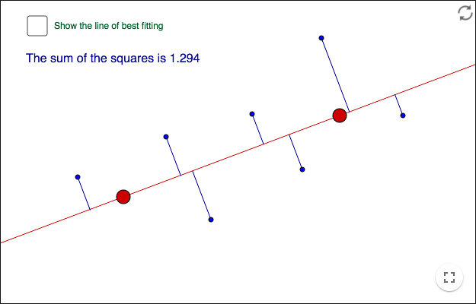
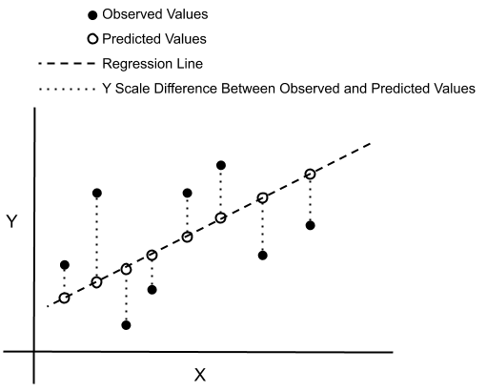
Least Squares Method - Least Squares finds parameters that minimize the squared error between predicted values and real data.
, If model is linear : y ​= w₀ ​+ w₁​x . Then w₀​ , w_{1​} so the total squared error is minimum
Real Life Example - Model : Price = w₀​+w_{1​} × Area , Least squares finds best line.
AI / ML usage : Linear Regression , Polynomial Regression , Kalman Filters
Area | Actual Price
800 | 50K
900 | 55K
1000 | 65K

Slide 10
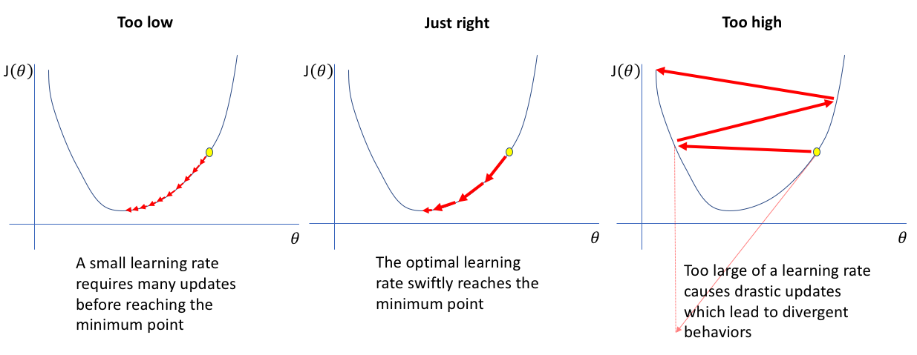
Step Length (Learning Rate) - In gradient descent: x_{k+1​}=x_{k}​− α ∇f (x_{k}​) , α - step length / learning rate
If step length is : Real Life Example - Walking downhill ,
Big steps → may slip past valley , Small steps → reach slowly
AI / ML - Just keep changing α - 0.1, 0.01 , 0.001 etc
Step Size | Result
Too Small | Slow Learning
Too Big | Oscillations
Proper | Fast Convergence

Slide 11
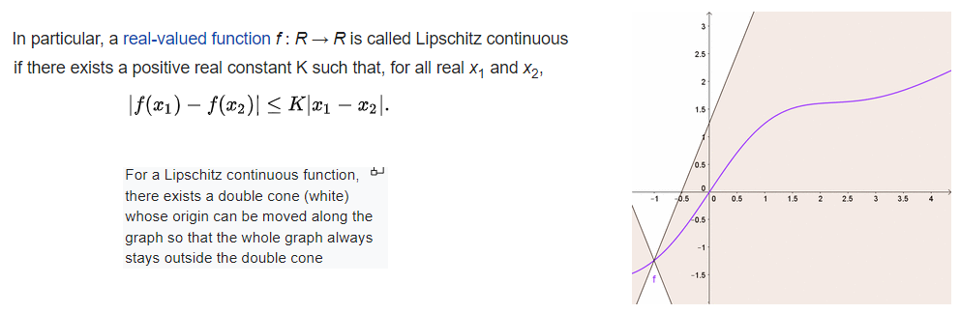
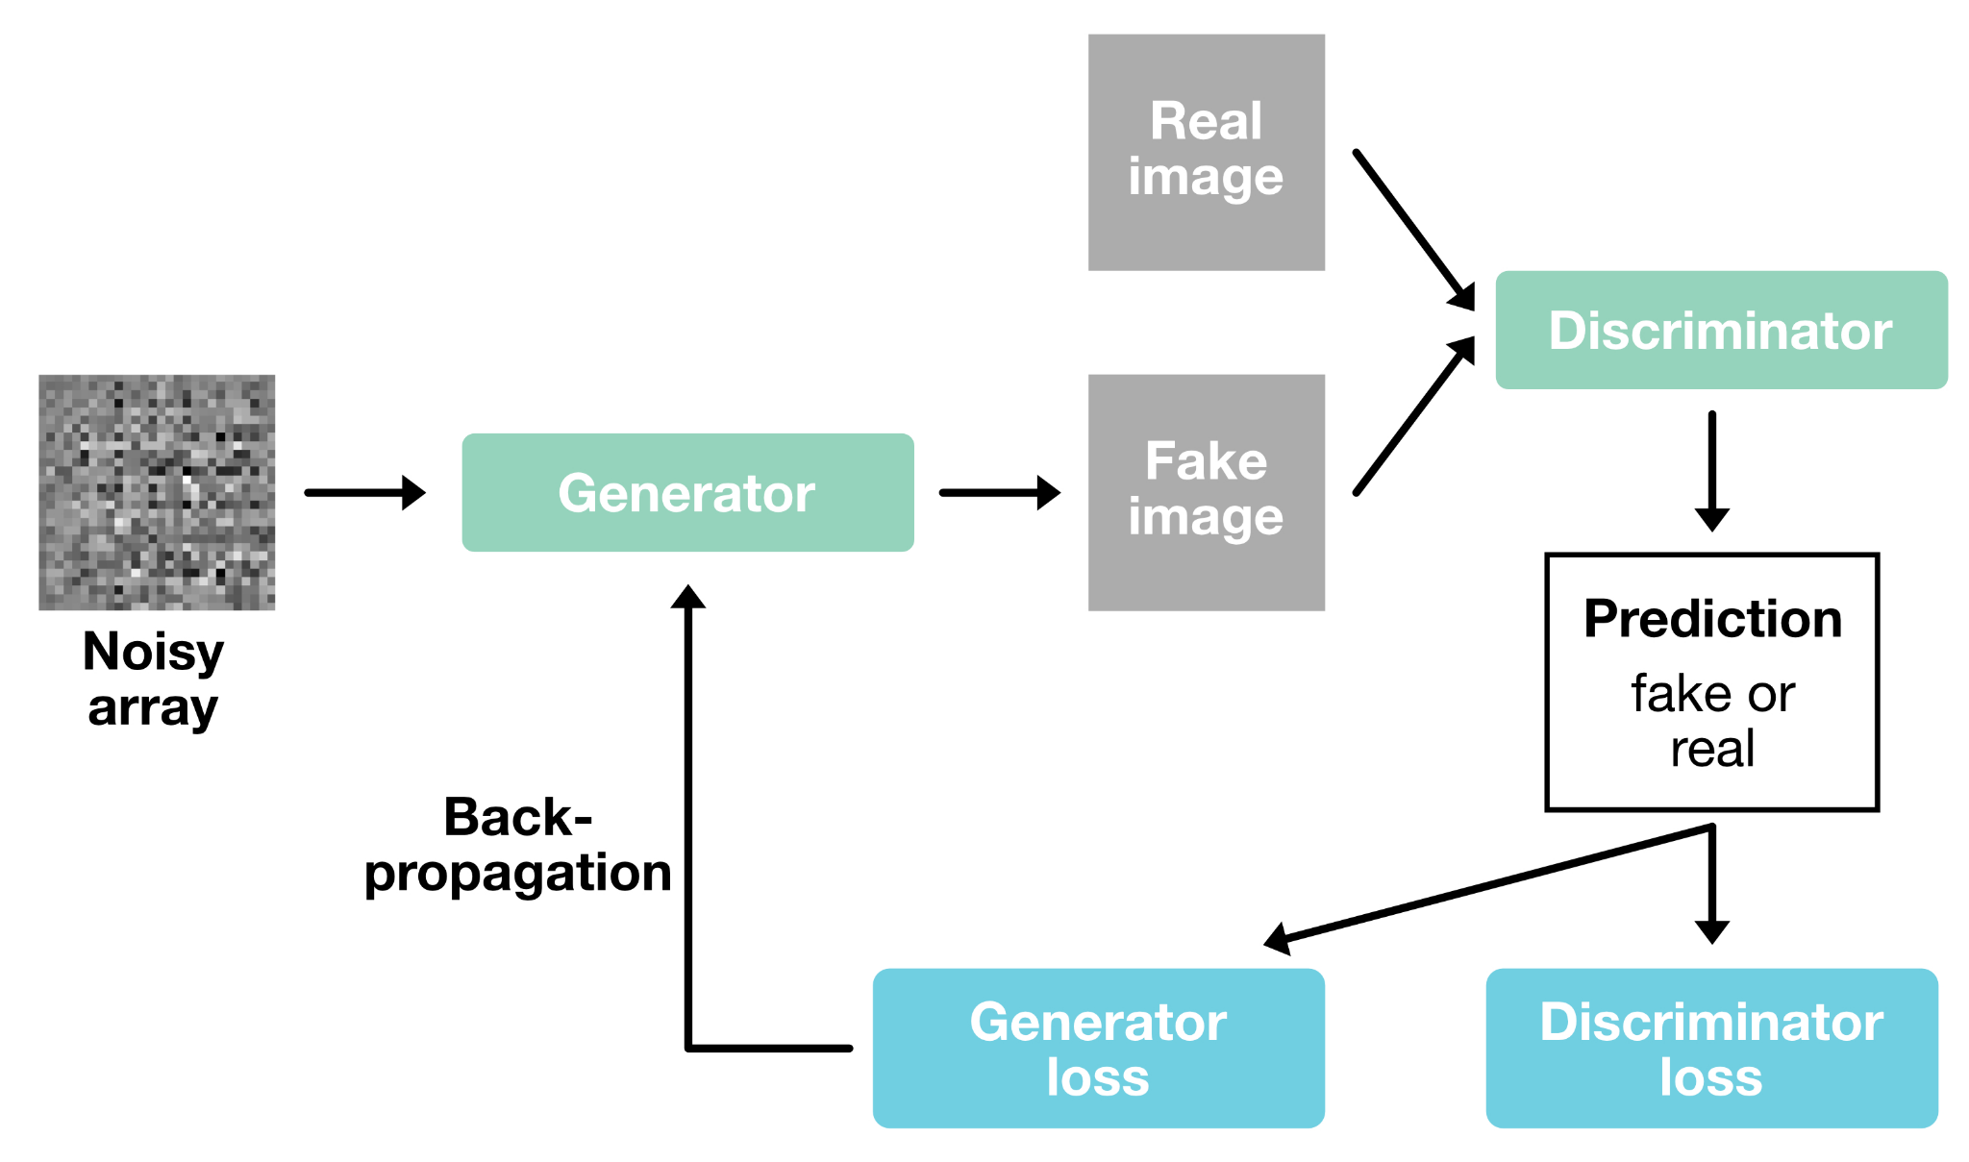
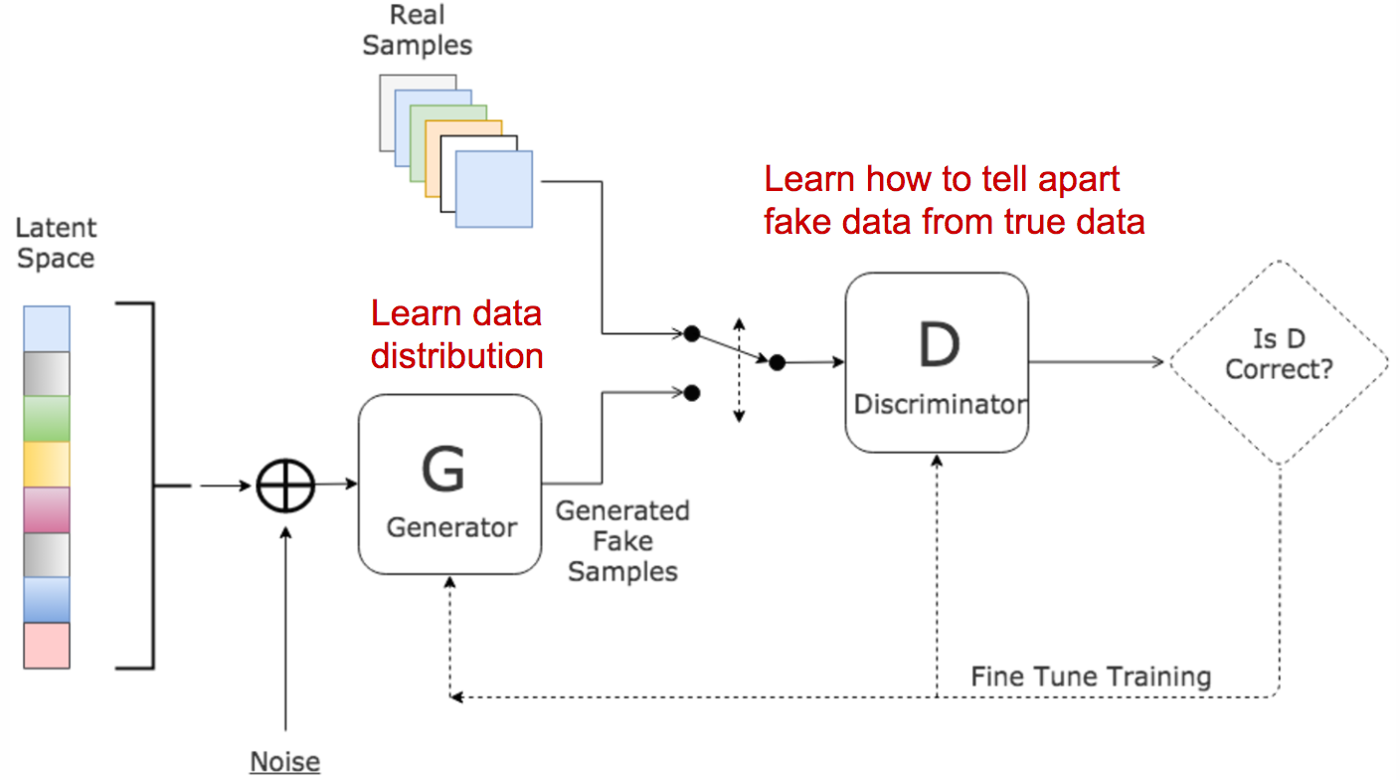
Lipschitz Function - A function is Lipschitz continuous if its slope cannot change too fast.∣ f(x₁​) − f(x_{2​}) ∣ ≤ L∣ x_{1​}− x_{2​}∣,L = Lipschitz constant.
Real Life Example : - Speed limit on a road , Car speed cannot change infinitely fast ,Slope of motion = bounded.
AI / ML Example :-
GAN training stability,
Wasserstein GAN
(Generative Adversarial Networks)

Slide 12
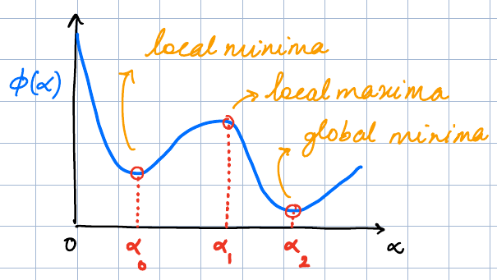
Lipschitz Gradient - A function has Lipschitz gradient if ∣∣ ∇ f(x) − ∇f(y) ∣∣ ≤ L ∣∣x − y∣∣ , Mathematical Meaning:- Gradient changes smoothly. Why it's Important ? Reason - Ensures gradient descent converges.
ML Example - Loss functions like: Mean Squared Error , Logistic Loss. (have Lipschitz gradients).
Exact Line Search - We find step size that exactly minimizes function along search direction. α = arg min f(x_{k}​+ α d_{k}​).
Real Life Example - Finding lowest point exactly along a straight road.
ML Example - Rarely used because of expensive , large datasets
Inexact Line Search
Instead of exact minimum, choose good enough step size.
Faster for real problems.
Used in:- Gradient descent , Quasi-Newton methods ,
Deep learning optimizers

Slide 13
Armijo Condition : Ensures sufficient decrease in function, f (x_{k}​+α d_{k}​) ≤ f (x_{k​}) + c₁​ α ∇f (x_{k}​)^{T} d_{k}.
Mathematical Meaning : Step must reduce loss sufficiently
Real Life Example - Negotiation discount (we accept reasonable discount, not perfect one)
ML Example - Used in : Backtracking line search , Large scale optimization
Wolfe Conditions
Two conditions - 1) Armijo condition - Decrease condition , 2) Curvature condition : ∇f (x_{k}​+ α d_{k}​)^{T} d_{k}​ ≥ c₂​ ∇f (x_{k}​)^{T}d_{k}​ .
Ensures slope is reduced
Why it’s Important ? Reason - Guarantees convergence
ML Example :- Used in: BFGS optimizer , L-BFGS
Zoutendijk’s Theorem
It states: if 1) descent direction used and 2)Wolfe conditions satisfied
Then ∑ cos²(θ_{k}​) ∣∣ ∇f( x_{k}​) ∣∣² < ∞ , Mathematical meaning - Gradient approaches zero (So algorithm converges).
Real Life Meaning- If we keep moving downhill properly, we will eventually reach valley.

Slide 14
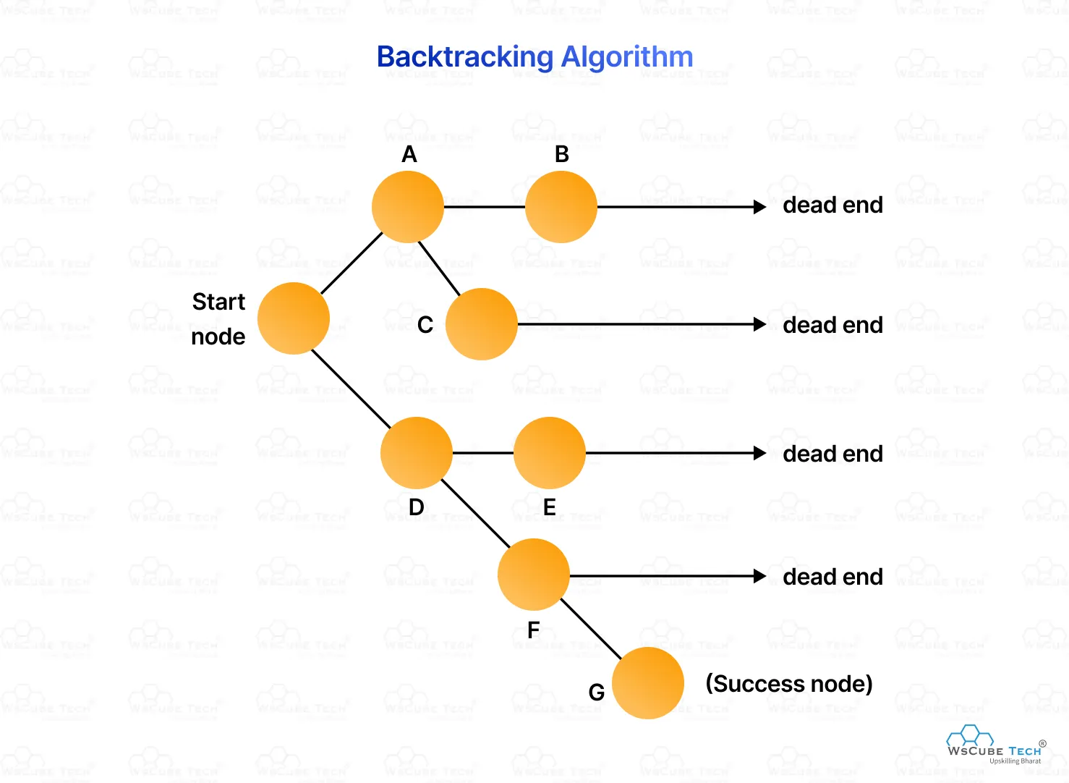
Backtracking Line Search
Simple algorithm to choose step size.
Start with : α = 1 , Then reduce: α = βα , until Armijo condition satisfied.
Real Life Example - We trying to park car
If car goes too far: reverse slightly , adjust steps.
ML Example :- Backtracking used in : Newton optimization ,
Deep learning training

Slide 15
Week 5
Table of Gradient Descent Variants: SGD, Mini-batch GD, Momentum, AdaGrad, RMSProp, Adam
Pure Newton’s Method and Damped Newton Method
Quasi Newton Method and it’s methods:
Davidon-Flecher powel Method
BFGS Method

Slide 16
Gradient Descent Variants - Gradient descent minimizes a loss function : x_{k+1 ​}= x_{k}​ − α ∇f(x_{k​})
Where x_{k}​ = current parameters , α = learning rate , ∇ f(x) = gradient
SGD (Stochastic Gradient Descent) : θ = θ − α ∇f _{i} ​(θ) , Uses one data point at a time.
Real-Life Example :- Learning to play cricket. (we adjust our technique after each ball.)
AI/ML Example - Neural networks , Online recommendation systems , Reinforcement learning
Method | Idea | Real life Analogy | AI/ML Usage
SGD | Use one Data Sample at a time | Learning from 1 Mistake at a time | Online Learning
Mini - Batch GD | Use small batch of data | Studying few Problems at once | Deep Learing
Momentum | Uses past direction to accelerate | Rolling Ball gaining speed | CNN Training
AdaGrad | Learning rate adjusts per parameter | Slowing down after many steps | NLP Sparse Features
RMS Prop | Fixes AdaGrad Decay issue | Adaptive walking speed | RNN Training
Adam | Combines Momentum + RMSProp | Smart driver adjusting speed & direction | Most Common Optimiser

Slide 17
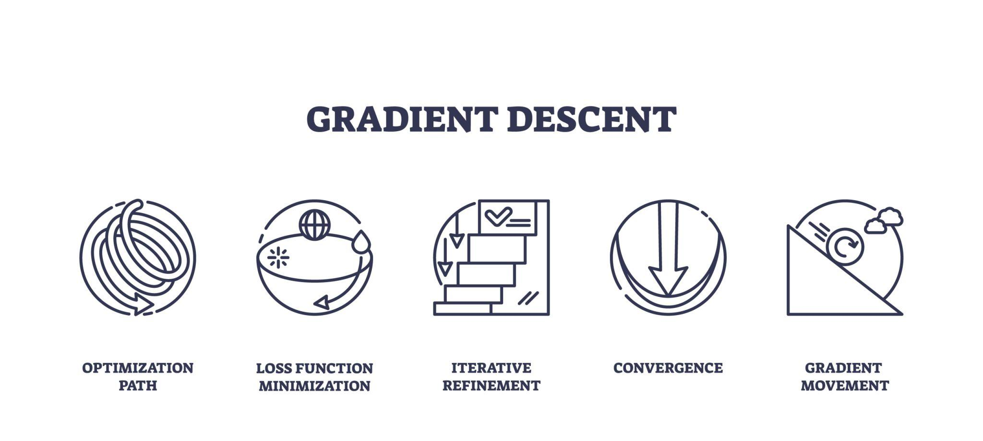
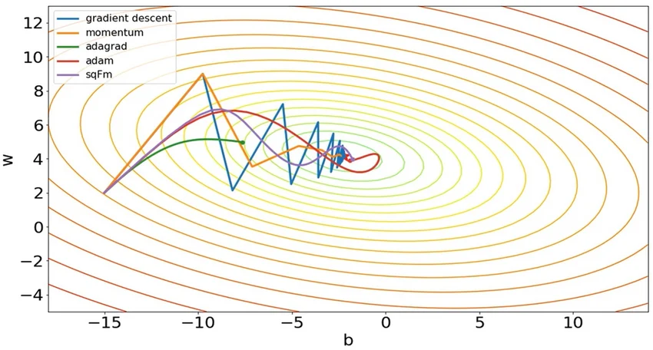
Mini-Batch Gradient Descent : Uses small batch of data. Example a Batch size = 16 /18 /20 /26 /30.
Real-Life Example - Instead of correcting after every exam question, you analyze 20 questions together.
AI/ML Example - Most deep learning training uses: 16 , 32 ,64,128
Momentum :- Update rule: v_{t}​ = β v_{t−1}​ + α ∇f(x) , x_{t+1}​ = x_{t​} − v_{t​} (Uses past gradients to accelerate.)
Real-Life Example - Rolling a heavy ball downhill. (Momentum keeps it moving.)
AI/ML Example - Used in training :
CNN models , computer vision networks

Slide 18

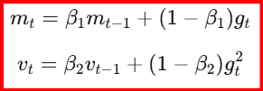
AdaGrad : Adapts learning rate per parameter. Where G_{t​} is sum of squared gradients.
Real-Life Example - When learning piano (we practice difficult keys more carefully.)
AI/ML Example - Sparse datasets , NLP tasks
RMSProp : Fixes AdaGrad problem (learning rate decay). E [g²] _{t} ​= β E [g²] _{t−1​} + (1−β) g²​_{t}
Real-Life Example - Walking on terrain while adjusting step length dynamically.
AI/ML Example : RNN training , speech recognition models
Adam (Adaptive Moment Estimation) : It Combines - Momentum + RMSProp
Real-Life Example -
Smart driver ( remembers past speed + adjusts according to road conditions )
AI/ML Example - Most common optimizer : transformers , GPT models , computer vision , reinforcement learning
Newton’s Method : Uses second derivative (Hessian). x_{k+1}​ = x _{k}​ − H⁻¹ ∇f , where H = Hessian matrix.
Real-Life Example - Using curvature of road to drive faster toward destination.
AI/ML Example - logistic regression , convex optimization problems
Damped Newton Method : Modified Newton method. x_{k+1 ​}= x_{k​} − α H⁻¹ ∇f , where α < 1 to avoid overshooting.
Real-Life Example - Driving downhill with controlled braking.
AI/ML Example - Used when Newton method becomes unstable.

Slide 19
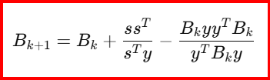
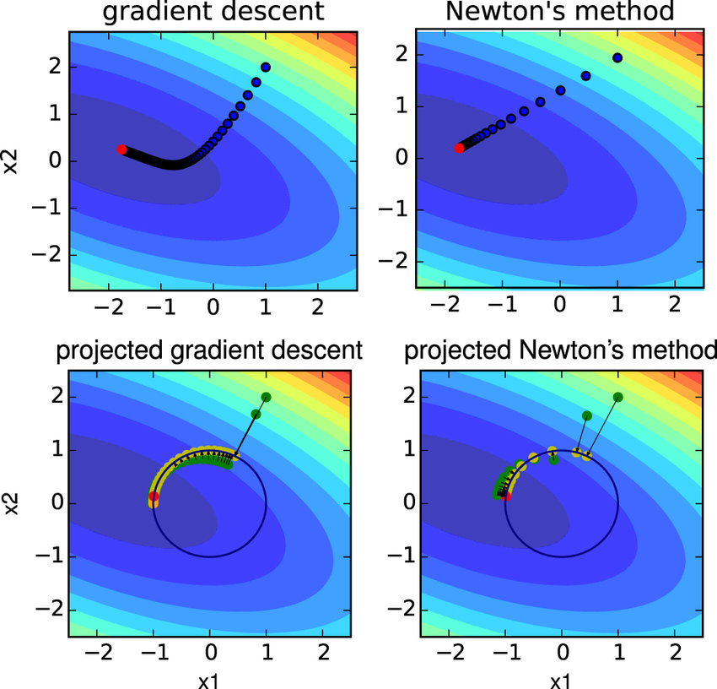
Quasi-Newton Methods : Newton requires computing Hessian , But Hessian is expensive . So we approximate Hessian.
Method - Instead of computing H, we update an approximation B_{k} .
Davidon-Fletcher-Powell (DFP) : One of the first quasi-Newton methods
Formula : Where s = x_{k+1​} − x_{k​} , y = ∇f_{k+1}​ − ∇f_{k​} ,
Real-Life Example : Improving a map of terrain while walking , You refine curvature estimates as you move.
AI/ML Example : Used in optimization libraries.
BFGS Method: Improved version of DFP, most widely used quasi-Newton method
Why BFGS is used more ? Reason : Stable , Fast convergence ,
Good for medium-scale problems
Real-Life Example : GPS navigation improving route estimation after each step.
AI/ML Example: scikit-learn optimization , logistic regression ,
support vector machines
Variant : L-BFGS used for large datasets
( BFGS : Broyden-Fletcher-Goldfarb-Shanno )

Slide 20
Mathematical approach (Explaining Difference in all the Above Methods) :
Let : f(x) = x² , Goal: min f(x) , Derivative: ∇ f(x) = 2x , Start from: x_{0​}= 4 , Learning rate: α = 0.1
SGD (Stochastic Gradient Descent)
Rule : x_{k+1} ​= x_{k​} − α (2x_{k​})
Iteration 1 :- Gradient g = 2(4) = 8 , Update x₁ ​= 4 − 0.1 (8) , x₁ ​= 3.2
Iteration 2 :- g = 2 (3.2) = 6.4 , x₂​ = 3.2 − 0.1 (6.4) , x_{2​} = 2.56
Conclusion - SGD slowly approaches minimum
Mini-Batch Gradient Descent
Lets take dataset has 4 samples :
Mini-batch size = 2
Average gradient: g = (2+4) /2 = 3
Now Update : x₁ ​= 4 − 0.1 (3) , x₁​ = 3.7
Conclusion - Mini-batch gives more stable update than SGD.
x | gradient
1 | 2
2 | 4
3 | 6
4 | 8

Slide 21

Momentum
Velocity formula : v_{t} ​ = β v_{t −1}​+ α g , Let β = 0.9
Iteration 1 : g = 8 , v₁​ = 0.9 (0) + 0.1 (8) , v₁​ = 0.8
Now Update : x₁ ​= 4 − 0.8 , x_{1 ​}= 3.2
Iteration 2 : g = 6.4 , v₂ ​= 0.9 (0.8) + 0.1 (6.4) , v₂​= 0.72 + 0.64 , v_{2​}= 1.36
Now Update : x₂​ = 3.2 − 1.36 , x_{2 ​}= 1.84
Conclusion - Momentum moves faster than SGD
AdaGrad
Learning rate becomes -
Iteration 1 : g = 8 , G = 8² = 64
Effective learning rate : α = 0.1/ 8 , α = 0.0125
Now Update : x_{1​} = 4 − 0.0125 (8) , x_{1​} = 3.9
Conclusion - Learning rate decreases

Slide 22
RMSProp
Uses moving average of squared gradient.
Let assume : β = 0.9
Iteration 1 : g = 8 , E [g²] = 0.9 (0) + 0.1 (64) , E [g²] = 6.4
Now Update : x_{1​}= 4 − [ 0.1(8) / Sqrt 6.4 ]​ , x₁ ​≈ 4 − 0.316 , x₁ ​≈ 3.684
Conclusion - RMSProp keeps learning rate stable.
Adam Optimizer (Uses two moments )
First moment: m = β₁​ m + ( 1− β_{1​} )g , Second moment : v = β₂​ v + ( 1 − β₂ ​) g²
Let take : β1​ = 0.9 , β2 ​= 0.999
Iteration 1 : g = 8 , m = 0.8 , v = 0.064
Now Update : x_{1​}= 4 − [ ​0.1(0.8) / sqrt 0.064 ] ​ , x₁ ​≈ 3.0
Conclusion - Adam converges very fast.

Slide 23
Pure Newton Method
Formula : x_{k+1​} = x_{k​} − [ f′(x) / f′′(x) ]
We take : f(x) = x^{2​} , f′(x) = 2x , f′′(x) = 2
Iteration 1 : x₁​= 4 − [ 8/ 2 ] , x_{1​}= 0
Conclusion - Newton reaches minimum in one step.
Damped Newton Method
adding step size: x_{k+1}​= x_{k}​ − α ( f′​ / f′′ )
Let α = 0.5 ,
Iteration 1 : x_{1​}= 4 − 0.5 (4) , x_{1​} = 2
Iteration 2 : x_{2​} = 2 − 0.5 (2) , x_{2​} = 1
Conclusion - More stable than pure Newton.
Quasi Newton Method:
Newton requires Hessian: H
Since computing Hessian is expensive.
Quasi-Newton approximates Hessian.

Slide 24


DFP Method (Numerical )
Let x₀ ​= 4 , Gradient : g_{0​}= 8 , Shifting to : x_{1​} = 3 , New gradient : g_{1​}= 6 ,
We Compute s = x₁ ​− x₀ ​= −1 , y = g₁​− g₀​ = −2
DFP updates approximate Hessian using -
Conclusion - It improves curvature estimate each step
BFGS Method
More stable update:
So if : s = - 1 , y = - 2
Conclusion - New Hessian estimate improves search direction ,
BFGS converges much faster than gradient descent.
Real AI/ML Example - Loss L(θ) , Optimization : θ_{k+1​}= θ_{k​} − α ∇L
AI model | Optimizer
CNN | Momentum / Adam
RNN | RMSProp
Transformers | Adam
Logistic Regression | BFGS

Slide 25
Questions
f(x) = x² + 2 x , Ans : x_{1​}= 1.4 , x_{2​}= 0.92
f(x) = x² , Ans : x₁​= 2.4 , x_{2​}= 1.44
f(x) = x²+ 4x + 4 , Ans : x₁​= −2
Apply Newton Method for : x²+ y² , and Find its Solutions.

Slide 26
Week 6
Conjugate Direction Method
Exact Solution for the Quadratic Equation
Fletcher Reeves Conjugate Gradient Method

Slide 27
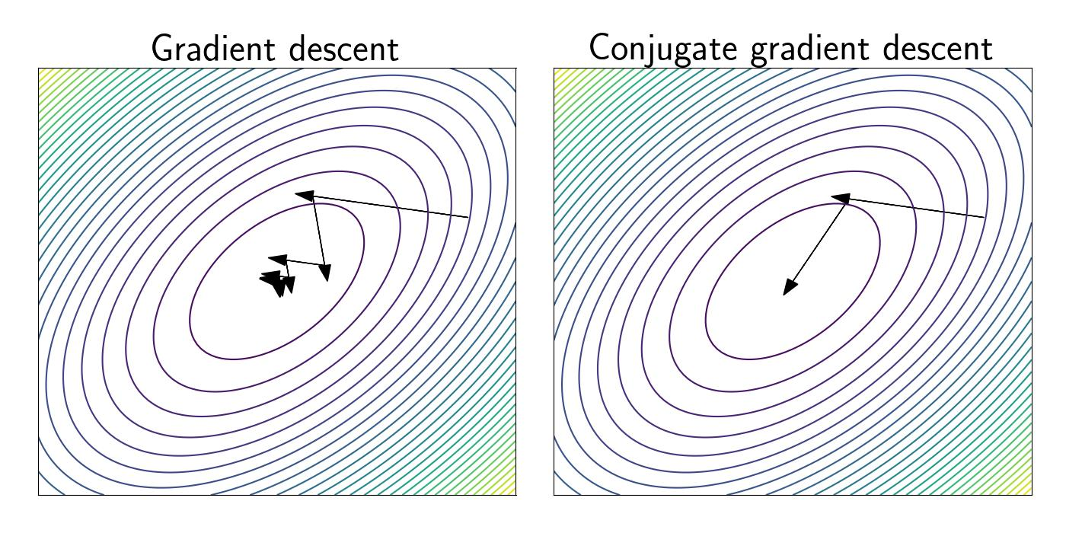
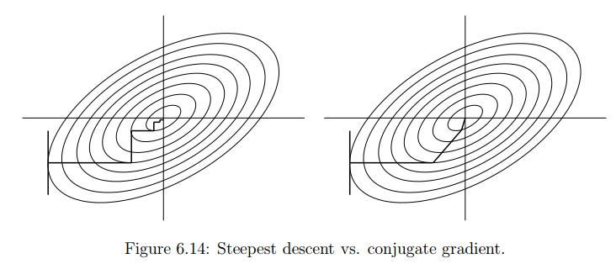
Conjugate Direction Method
Approach - Instead of moving only along the negative gradient (steepest descent), we move along special directions called conjugate directions. Mathematical Definition : Directions d_{i} and d_{j} are conjugate w.r.t matrix A if: d_{i}^{T​} A d_{j}​ = 0 , (i ≠ j)
Why Needed?
Reason : Gradient descent is Zig-zags , Slow convergence while Conjugate directions remove zig-zag ,reach minimum faster.
Real-Life Example: Imagine walking in valley [Gradient descent → zig-zag walking, Conjugate direction → smart diagonal shortcuts ]
AI/ML Connection : Used in - Large linear systems , Quadratic loss problems , Training ML models without computing Hessian.
Kernel methods (SVM).

Slide 28
Algorithm (Conjugate Direction Method):
Start with x_{0 ,} For k = 0,1,2,…
Choose direction d_{k}​ such that: d_{i}^{T​} A d_{j}​ = 0
Compute step size (exact line search) : α_{k​} = [ d_{k}^{T}​ ( b − A x_{k} ​) ] / [ d_{k}^{T}​ A d_{k} ]
Update : x_{k+1 ​}= x_{k​} + α_{k} ​d_{k}
Result - The method converges in at most n steps ( for n - dimensional problem )
Each direction removes error in one dimension
Exact Solution for Quadratic Function
Function : f(x) = ½ ​ x^{T} A x − b^{T} x
Gradient : ∇f(x) = A x − b
Optimality Condition : Set gradient to zero - A x∗ − b = 0 , A x∗ = b
Exact Solution : x∗ = A⁻¹ b
Conditions: A must be invertible
Interpretation : We solve a system of linear equations instead of iterative optimization.
Real-Life Example : Electrical Circuit Analysis [ Ohm’s law system: A x = b , where x → currents ,A → resistance matrix ]
AI/ML Connection : Linear Regression [ w = (X ^{T} X)⁻¹ X^{T} y ]
This is exactly the quadratic optimization solution.

Slide 29
Fletcher–Reeves Conjugate Gradient Method A practical algorithm to generate conjugate directions without computing A explicitly.
Algorithm :
Step 1: Initialization -
x_{0​} given , g₀ ​= ∇f (x_{0​}) , d_{0​} = − g_{0​}
Step 2: Iteration -
(a) Step size : α_{k} = ( g_{k}^{T} ​g_{k}​ ) / ( d_{k}^{T} A d_{k} )
(b) Update solution : x_{k+1} ​ = x_{k} ​ + α_{k}​ d_{k​}
(c) New gradient : g_{k+1}​ = ∇f (x_{k+1}​)
(d) Compute β : β_{k​} = ( g_{k+1}^{T ​}g_{k+1​} ) /( g_{k}^{T} g_{k} )
(e) New direction : d_{k+1​} = −g_{k+1} ​ + β_{k} ​ d_{k​}
Properties :
1) Directions are automatically conjugate 2) No need to compute Hessian 3) Converges in at most n steps (for quadratic case)
4) Combines: Gradient (current slope) + New Direction [ Smarter than gradient descent ]
Real-Life Example :
Navigation System - Gradient descent → follow steepest slope
- Fletcher-Reeves → remembers past movement and avoids repeating mistakes
AI/ML Connection: Used in Large-scale optimize,Train ML models with huge data,Solving linear systems (Gaussian Process,Kernel methods)

Slide 30

Numericals 1) Conjugate Direction Method (Independent smart directions)
Minimize: f(x) = ½ x^{T} A x − b^{T} x.
Where , Start with x_{0​} = (0 , 0)
Use two conjugate directions : d₀ ​= (1,0) , d₁​ = (0,1)
Solution :
Step 1: First Direction
r₀ ​= b − A x₀ ​= (8 , 4)
α₀ = d₀^{T​} r₀​​ / d₀^{T} A d₀
a₀ ​= 8/4 ​ = 2
Update : x_{1​} = x_{0​} + 2(1 , 0) = (2 , 0)
Step 2: Second Direction
r₁ ​= b − A x₁​
A x₁​ = (8 , 0)
r₁ ​= (8, 4) − (8 ,0) = (0 ,4)
α₁ = d₁^{T​} r₁​​ / d₁^{T} A d₁ , α_{1​} = 4/2 ​= 2
Update : x_{2​} = (2, 0) + 2(0, 1) = (2, 2) Final Answer : x∗ = (2 ,2) . What we Compute ? Ans: α and updates

Slide 31


2) Exact Solution for Quadratic Equation (Solve system directly)
Problem : Solve ½ x^{T} A x − b^{T} x , where
Solution :
Step 1: Optimal condition Ax = b
Step 2: Solve system
Step 3: Equations 2 x₁​ = 6 ⇒ x₁​ = 3
4 x_{2​} = 8 ⇒ x₂ ​= 2
Final Answer x∗ = (3 , 2) . What we Compute ? Ans: Solve Ax = b
3) Fletcher–Reeves Conjugate Gradient Method (Efficient practical method)
Problem : Minimize f(x,y) = x² + y²
Start : x_{0​} = (1 , 2)
Solution :
Step 1: Gradient
g_{0 ​}= (2 , 4)
d₀ ​= (−2 ,−4)

Slide 32
Step 2: Step size
α₀ = (g₀^{T​} g₀ ) / ( d₀^{T}​ A d_{0​} )
Here: A = 2 I g₀^{T​} g₀​ = 4 + 16 = 20
d₀^{T}​ A d_{0​} = 2 (4+16) = 40
α₀​ = 20/40​ = 0.5
Step 3: Update x₁ ​= (1 ,2) + 0.5 (−2 ,−4)
x_{1​} = (0, 0)
Step 4: New Gradient
g_{1​} = (0, 0)
Step 5: Compute β
β_{0​} = g₁^{T ​}g_{1​} / g₀^{T ​}g₀ = 0
Step 6: New direction
d_{1​} = −g₁​ + 0 ⋅ d₀ ​= 0 Final Answer : x∗ = (0, 0). What we Compute ? Ans: α, β, direction

Slide 33


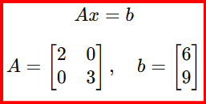
Practise Questions :
Conjugate Direction Method
Minimize: f(x) = ½ x^{T} A x − b^{T} x , where , Given : x₀ ​= (0,0) , d₀​ = (1 ,0)
Find : α₀ , x₁
Using same problem above, take d₁ ​= (0,1) , Find : α₁ , x₂
Check whether the directions - d₀ ​= (1,0), d₁​ = (0,1) , are conjugate w.r.t Verify : d₀^{T} A d₁ ?
4) Exact Solution of Quadratic Function
Solve : . Find x* ?
5) Find the minimum of: f(x,y) = x² +2 y² − 4x − 8y
Find gradient , Set ∇f = 0

Slide 34
Week-7
Constrained Optimisation
Concept of Feasible and Descent Direction
Geometrical Optimality
Fritz John Problem

Slide 35
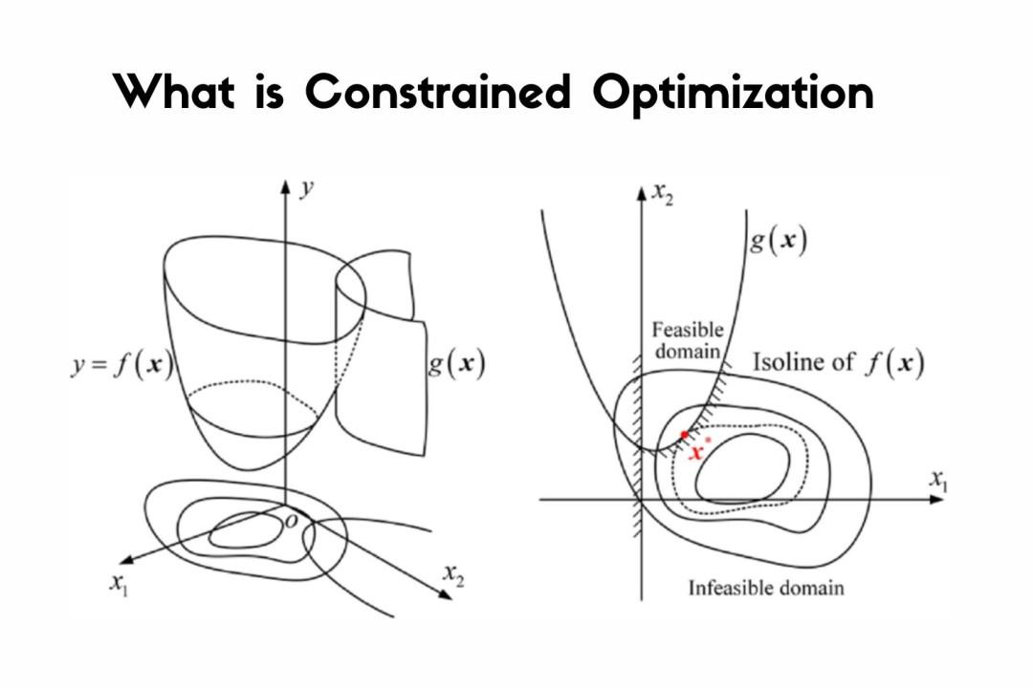
Constrained Optimization General Problem :- min f(x) , subject to: g_{i} ​(x) ≤ 0 (i = 1,…,m) , h_{j​} (x) = 0 (j = 1,…,p)
Types : Inequality constraints → g(x) ≤ 0
Equality constraints → h(x) = 0
Feasible Set : Ω = { x ∣ g_{i} ​(x) ≤ 0 ,h_{j} ​(x) = 0 } [ All points satisfying constraints. ]
Idea - We want to optimize, but only within allowed region.
Real-Life Example : Budget-Constrained Shopping
Minimize cost : min Cost (x) , Subject to : Budget ≤ 5000
AI/ML Connection : Used in - Support Vector Machines (SVM) , Regularization constraints , Resource-constrained ML models.
Feasible Direction & Descent Direction
Feasible Direction : A direction d is feasible at point x if moving slightly in that direction keeps us inside constraints.
For inequality constraint : ∇g_{i} ​(x)^{T} d ≤ 0
Descent Direction : A direction d is descent direction if : ∇ f(x)^{T} d < 0
Mathematical Meaning : Function value decreases along that direction.

Slide 36
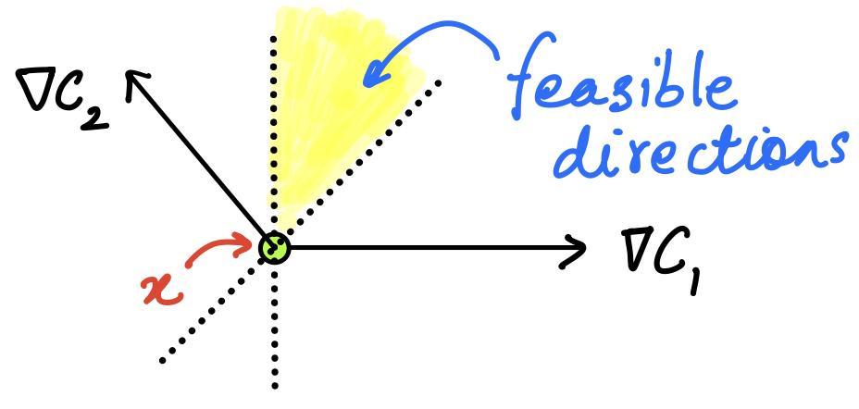
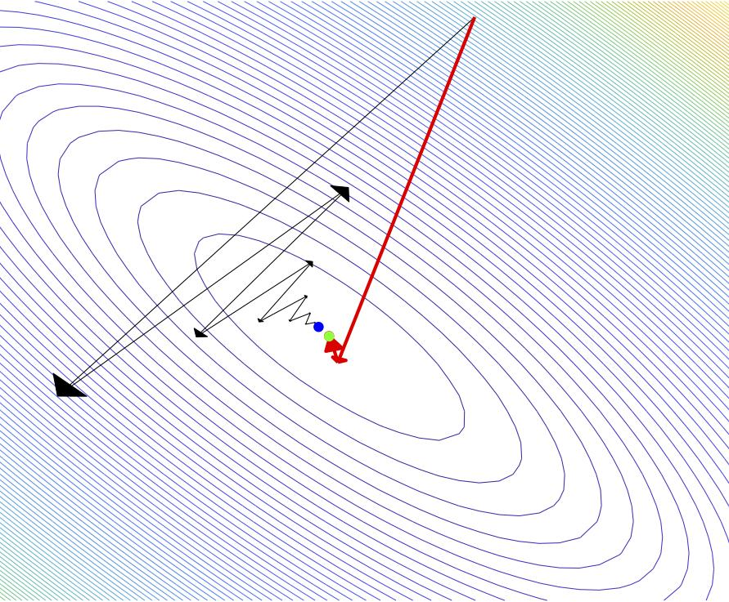
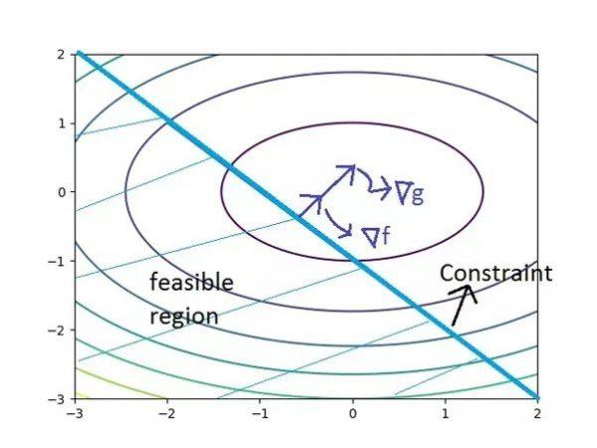
Idea : We want a direction that is - Feasible , Descent
Real-Life Example - Driving inside a road: Road → feasible region ,
Moving downhill → descent direction
AI/ML Connection : Used in - Projected Gradient Descent , Constrained neural networks , Adversarial robustness training
Geometrical Optimality Condition
Idea : At optimal point - No feasible direction can reduce the function.
Mathematical Condition : If x∗ is optimal - ∇ f(x∗)^{T} d ≥ 0 ∀ d ∈ feasible directions.
Interpretation : We cannot go downhill without leaving feasible region. We are at “best possible point within constraints”

Slide 37
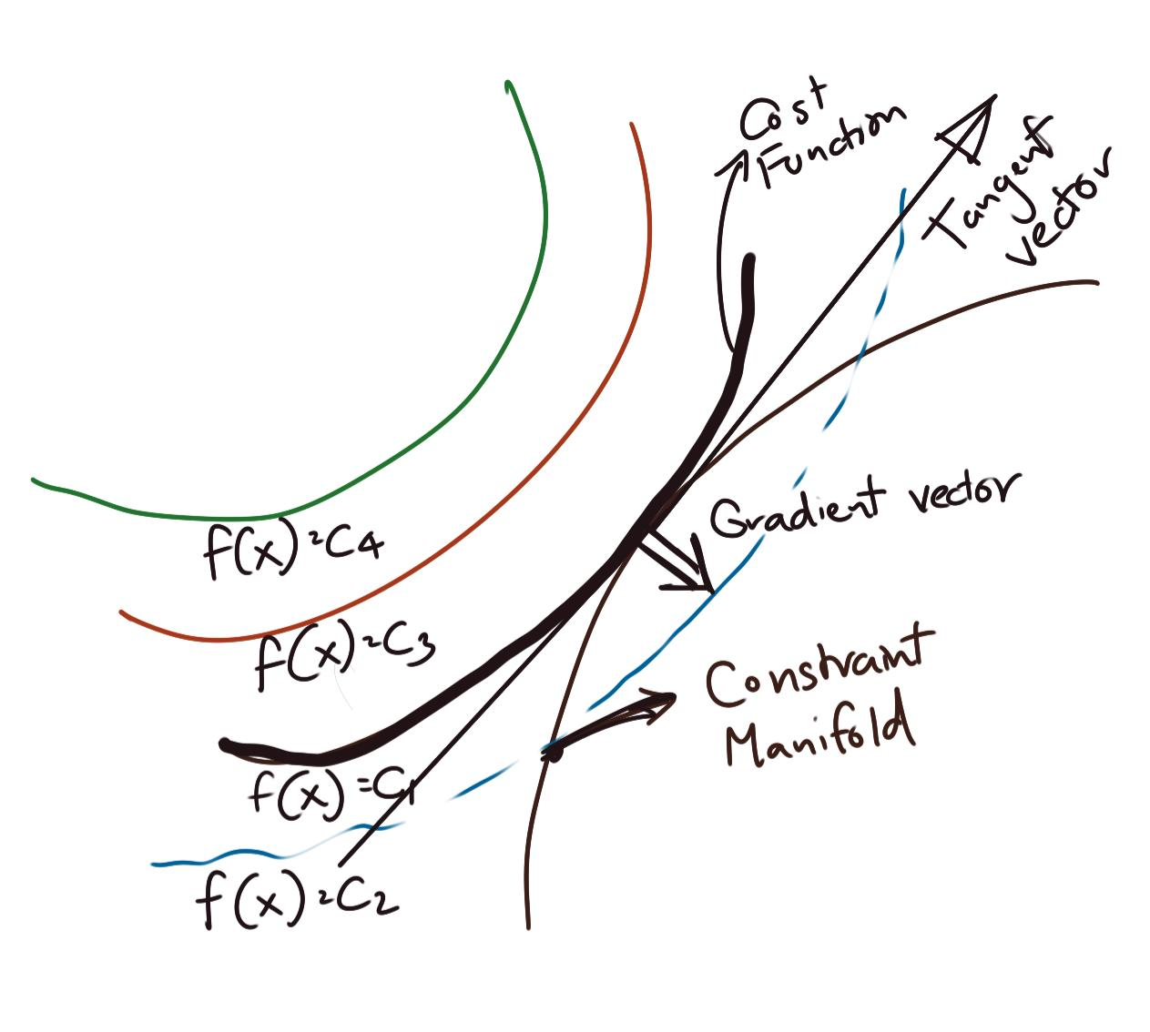

Idea : At optimum - Gradient is blocked by constraint boundary.
Real-Life Example : Water flowing in a container - It settles at lowest point ,
But constrained by container walls.
AI/ML Connection : Used in - SVM margin maximization , Constrained optimization layers
Reinforcement learning constraints
Fritz John Conditions
General optimality conditions for constrained optimization.More general than KKT conditions. [ Karush-Kuhn-Tucker (KKT) conditions are first-order necessary conditions for a solution to be optimal in nonlinear programming, extending Lagrange multipliers to inequality constraints. ]
Problem : min f(x) , subject to : g_{i} ​(x) ≤ 0
Fritz John Conditions : There exist multiplier - λ₀​, λ_{1​}, …, λ_{m}​ , such that :
1)Stationarity :
2)Non-negativity : λ_{i​} ≥ 0
3)Complementary Slackness : λ_{i}​ g_{i​} (x∗) = 0
4)Not all multipliers zero : (λ0​,λ1​,…,λm​) ≠ 0
Special Case (KKT) : If λ_{0​} = 1 , Then Fritz John → KKT conditions

Slide 38
At optimum : Objective gradient + constraint gradients balance each other.
Real-Life Example : Balancing forces - Objective → pulling in one direction
Constraints → opposing forces. ( System stabilizes at equilibrium )
AI/ML Connection : Used in - SVM optimization , Lagrangian dual problems , Constrained deep learning
Concepts | Meaning | Simple Idea | Key Formula
Constrained Optimization | Optimize with Restrictions | Boundary | g(x) ≤ 0
Feasible Direction | Stay inside Region | Allowed Movement | ∇ g^{T} d ≤ 0
Descent Direction | Reduce Function | Downhill Movement | ∇ f^{T} d < 0
Geometric Optimality | No better Feasible Move | Best Point within Boundary | ∇ f^{T} d ≥ 0
Fritz John | General Optimality | Balance of Forces | Λ₀ ​∇f + ∑ λ_{i}​ ∇ g_{i}​ = 0

Slide 39
Numerical Sample Question
Constrained Optimization (Basic Problem)
Problem : f(x,y) = x² + y² ,Subject to: x+y−1 = 0
Solution (Using Lagrange Method)
Step 1: Lagrangian : L = x² + y² + λ (x+y−1)
Step 2: Partial derivatives : ∂L/∂x = 2x + λ = 0 , ∂L​/∂y = 2y+λ = 0 , x+y−1 = 0
Step 3: Solve : From first two : 2x = 2y ⇒ x = y , Substitute : x+x = 1⇒ x= ½ , y = ½ ​ ​
Final Answer :- ( x∗ , y∗ )=( ½ ​ , ½ ​)
Feasible Direction
Problem : Given constraint : g(x,y) = x+y−1 ≤ 0 . At point (0,1) , Check whether direction : d=(1,−1) is feasible.
Solution
Step 1: Gradient : ∇g = ( 1, 1 )
Step 2: Feasibility condition : ∇g^{T} d ≤ 0 => (1,1)⋅(1,−1) = 1−1 = 0
Since: 0 ≤ 0
Direction is feasible.

Slide 40
3) Descent Direction
Problem : Given : f(x,y) = x² + y² . At point: (1,1) , Check whether : d = (−1,0) is a descent direction.
Solution
Step 1: Gradient : ∇f = (2x,2y) = (2,2)
Step 2: Check condition : ∇f^{T} d < 0 => (2,2) ⋅ (−1,0) = −2
Since: −2<0
Direction is descent direction.
4)Geometrical Optimality
Problem :- Minimize : f(x,y) = x² + y² . Subject to: x+y ≤ 1 , Check whether point: (0.5,0.5) is optimal.
Solution
Step 1: Gradient : ∇f = (2x,2y) = (1,1)
Step 2: Constraint gradient : ∇g = (1,1)
Step 3: Check condition : At boundary : ∇f = λ ∇g => (1,1) = λ(1,1) => λ=1
Condition satisfied → optimal.

Slide 41
5)Fritz John Problem
Problem : Minimize : f(x,y) = x² + y² . Subject to: g(x,y) = x+y−1 ≤ 0 , Find optimal solution using Fritz John conditions.
Solution
Step 1: Gradients : ∇f = (2x,2y) , ∇g = (1,1)
Step 2: Fritz John condition : λ₀ ​∇f + λ₁​ ∇g = 0 => λ₀ ​(2x,2y) + λ₁ ​(1,1) = 0
Step 3: Solve : 2 λ₀ ​x + λ_{1​} = 0 => 2 λ₀ ​y + λ₁​ = 0
Subtract: x = y
Step 4: Constraint : x+y = 1 , 2x = 1⇒ x=½ ​ , y = ½
Step 5: Multipliers : λ_{1​} = −2 λ₀ ​x = −λ_{0​​}
Final Answer : (x∗, y∗) = (½ ​, ½ ​)
Fritz John (Concept Check Problem)
Problem : Check if point satisfies Fritz John : f(x) = x² , g(x) = x−2 ≤ 0 , At x∗ = 2
Solution
Step 1: Gradients : ∇f = 2x = 4 , ∇g = 1
Step 2: Condition : λ₀​(4) + λ₁​(1) = 0 , Choose:- λ₀ ​= 1, λ₁ ​= −4 , Check feasibility: g(2) = 0 ,
Fritz John satisfied

Slide 42
Questions
1)Constrained Optimization
Q1 - Minimize: f(x,y) = x² + y² , Subject to: x+y = 2 . Find optimal x , y.
Q2 - Minimize: f(x,y) = x² + y² , Subject to : x = 1 . Find optimal y.
2)Feasible Direction
Q3 - Given constraint: g(x,y) = x+y−2 ≤ 0 . At point : (1,1) , Check if direction: d=(1,0) is feasible.
Q4 - For same constraint above, check whether: d = (−1,−1) , is feasible.
Q5 - g(x,y)=x² + y² − 4 ≤ 0 . At point: (1,1) , Check whether: d = (1,1) , is feasible
Do the Descent Direction & Geometrical Optimality of the above Numericals
3) Fritz John Conditions
Q7 - Given : f(x,y) = x² + y² , g(x,y) = x+y−2 ≤ 0 . Write Fritz John condition equation.
Q8 - Given gradients: ∇f = (2,2) , ∇g = (1,1) . Write multiplier equation.

Slide 43
Week 8
KKT Conditions
SVM ( Support Vector Machine )
Fritz John Conditions (Unconstraint Optimization)

Slide 44


KKT (Karush–Kuhn–Tucker) Conditions Problem (General Constrained Optimization) - min f(x) , subject to : g_{i​} (x) ≤ 0 ( i = 1,…,m ) , h_{j​} (x) = 0 ( j = 1 ,…,p )
Lagrangian :
λ_{i}​ → multipliers for inequalities
μ_{j}​ → multipliers for equalities
KKT Conditions : At optimum x∗, there exist λ_{i} , μ_{j​} such that :
1) Stationarity :
2) Primal Feasibility : g_{i}​ (x∗) ≤ 0 , h_{j}​ (x∗) = 0
3) Dual Feasibility : λ_{i}​ ≥ 0
4) Complementary Slackness : λ_{i​} g_{i} ​(x∗) = 0
Geometric Meaning : a) The objective gradient is balanced by active constraints’ gradients.
b) Only active constraints ( where g_{i} (x∗) = 0 ) influence the solution.
Real-Life Example : Diet optimization - Minimize cost while meeting nutrition constraints.
At optimum - Some constraints are active (e.g., minimum protein met exactly)
Others inactive (e.g., vitamin limit not tight)
AI/ML Connection : Core to SVM training , Used in regularization (L1/L2 constraints) , Appears in resource-constrained ML (edge devices)

Slide 45
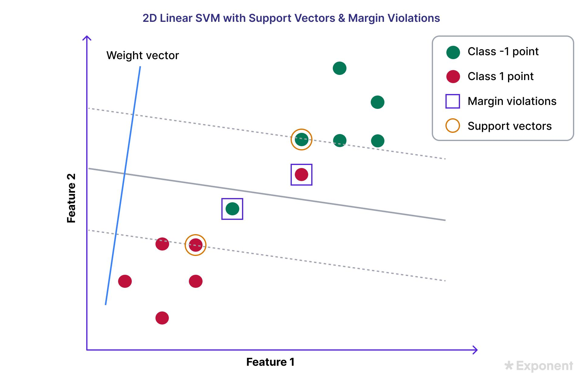



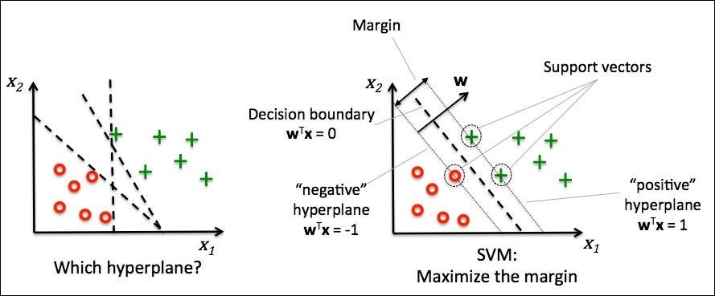
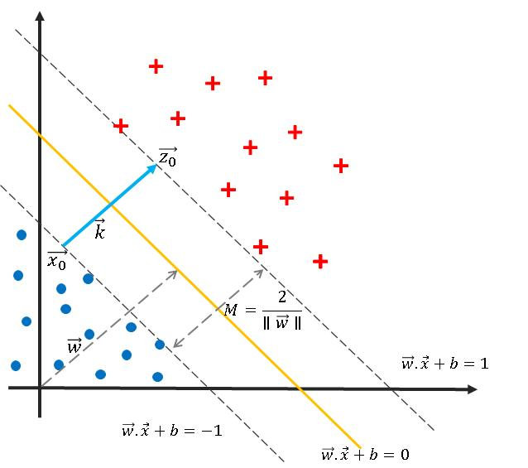
Support Vector Machine (SVM)
Aim : Find a maximum margin hyperplane that separates two classes.
Hard-Margin SVM (Linearly Separable)
Given data (x_{i} , y_{i} ) , y_{i} ​∈ {−1,+1} : , subject to : y_{i} ​(w^{T} x_{i​} + b ) ≥ 1
Lagrangian (Using KKT) :
c) KKT Conditions in SVM i) Stationarity :
ii) Complementary Slackness : α_{i} ​[ y_{i} ​( w^{T} x_{i​} + b ) − 1 ] = 0
iii) α_{i} ​≥ 0
Key Idea : Only points with α_{i} > 0 matter → Support Vectors
Real-Life Example : Email Spam Detection
Emails → data points
Boundary → separates spam vs non-spam
Support vectors → critical borderline emails
AI/ML Connection : SVM is used in
Text classification , Face detection ,
Bioinformatics , Kernel methods (non-linear SVM)

Slide 46

Fritz John Conditions
General Form (Constrained) : min f(x) , g_{i} ​(x) ≤ 0
Fritz John Conditions : There exist multipliers: λ0​,λ1​,…,λm​ , such that :
1)Stationarity :
2)Dual Feasibility: λ_{i} ​≥ 0
3)Complementary Slackness : λ_{i​} g_{i} ​(x∗) = 0
4)Non-triviality : (λ0​,λ1​,…,λm​) ≠ 0
Relation to KKT : If λ₀ = 1 → becomes KKT conditions , Fritz John is more general (does not require constraint qualification)
Special Case: Unconstrained Optimization
If no constraints: min f(x) , Then: ∇f (x∗) = 0 , This is Fritz John reduced form.
Real-Life Example : Force balance system
[ Objective → one force , Constraints → opposing forces , At equilibrium → all forces balance ]
AI/ML Connection : Used in Lagrangian dual problems , Basis of SVM optimization theory ,
Appears in deep learning constrained training

Slide 47
TABLE
Concept | Meaning | Equation | Use
KKT | Balance between objective & constraints | ∇f + ∑λ∇g = 0 | Standard constrained optimization
SVM | Best separating boundary | min ½ ​∥w∥² | Classification
Fritz John | General condition for optimality | Λ₀​ ∇f + ∑ λ_{i} ​∇g_{i}​ = 0 | General optimality
Unconstrained | Flat slope at optimum | ∇f = 0 | Simple optimization

Slide 48
NUMERICAL SOLUTION
1)KKT Conditions (Equality Constraint)
Problem - Minimize: f(x,y) = x² + y² , Subject to : x + y = 1
Solution :
Step 1: Lagrangian : L = x² + y² + λ(x + y − 1)
Step 2: Stationarity : ∂L​/∂x = 2x + λ = 0 , ∂L/∂y = 2y + λ = 0
Step 3: Solve : 2x = 2y ⇒ x = y , x+y = 1⇒ 2x = 1 , x=½ ​, y=½ ​
Final Answer : (x∗,y∗)=(1/2​ , 1/2​)
2) KKT Conditions (Inequality Constraint)
Problem - Minimize : f(x) = x² , Subject to : g(x) = x−1 ≥ 0
Solution: Rewrite constraint: g(x) = 1−x ≤ 0
Step 1: Lagrangian : L = x²+ λ(1−x)
Step 2: Stationarity : dL/dx ​= 2x − λ = 0 , λ = 2x
Step 3: Complementary slackness : λ(1−x) = 0
Case 1: x<1 => Not feasible → reject
Case 2: x=1 => λ = 2
Final Answer : x∗ = 1

Slide 49
3) SVM (Hard Margin)
Problem : Given points - Class +1: (2,2),(4,4)
Class -1: (2,0),(4,0) , Find separating hyperplane.
Solution :
Step 1: Assume form : w^{T}x + b = 0 , Let: w = (w1​ , w2​)
Step 2: Constraints : For +1: w₁​x + w₂​y + b ≥ 1
For -1: w₁​x + w₂​y + b ≤ −1
Step 3: Observation : Points differ only in y-direction , So choose : w = (0,1)
Step 4: Find b , For (2,2) : 2 + b = 1 ⇒ b = −1 ,
Final Hyperplane : y − 1 = 0
Answer : w = (0,1) , b = −1
4) SVM (Support Vectors Identification)
Problem : Given hyperplane: y = 1
Find support vectors from : (2,2), (4,4), (2,0), (4,0)
Solution : Support vectors lie on: y = 2 and y = 0 , Closest points : (2,2), (2,0)
Answer : Support vectors = (2,2),(2,0)

Slide 50
5)Fritz John Conditions
Problem : Minimize: f(x,y) = x² + y² , Subject to : g(x,y) = x + y −2 ≤ 0
Solution :
Step 1: Gradients : ∇f = (2x , 2y) , ∇g=(1,1)
Step 2: Fritz John equation : λ_{0​} (2x,2y) + λ₁​ (1,1) = 0
Step 3: Solve : 2λ₀ ​x + λ₁​ = 0 , 2λ_{0​} y + λ₁​ = 0 => Subtract : x = y
Step 4: Constraint : x + y = 2 , 2x = 2 ⇒ x = 1 , y = 1
Step 5: Multipliers : λ₁​ = −2 λ₀​
Final Answer : (x∗, y∗) = (1,1)
6)Fritz John (Unconstrained Case)
Problem : Minimize : f(x) = x² − 4x
Solution :
step 1: Gradient : df/dx = 2x − 4
Step 2: Set zero : 2x −4 = 0 , x = 2
Final Answer : x∗ = 2

Slide 51
Practise Question
A)KKT
1) Minimize: f(x) = x² , Subject to: x ≥ 1 , Find optimal x using KKT.
2) Minimize: f(x,y) = x² + y² , Subject to: x+y = 2 , Find optimal x,y .
3) Write the Lagrangian for: f(x,y) = x² + y² , Subject to: x+y−1 ≤ 0
B) SVM
1)Given two points: Class +1: (2,2)
Class -1: (2,0) , Suggest a separating line.
2)Given hyperplane: y= 1 , Classify point (2,2) and (2,0)
C)Fritz John Conditions
1)Write Fritz John condition for: min f(x) , subject to : g(x) ≤ 0
D)Unconstrained Optimization (Fritz John Case)
1)Find minimum of: f(x) = x²− 4x
2)Find stationary point of: f(x) = x² + 2x + 1

Slide 52
Week 9
KKT
SVM explained in detailed in the recorded classes

Slide 53
Week 10
Numerical methods for Constrained Optimisation
Lagrange Multiplier Method, Penalty Method
Quadratic Penalty Function and it’s Variants: Exact Penality Function

Slide 54
Lagrange Multiplier Method
Equality Constraints (Problem) : min f(x) subject to h(x) = 0
Lagrangian : L(x,λ) = f(x) + λ h(x)
Optimality Conditions : ∇_{x}​L =∇ f(x) + λ ∇h(x) = 0 , h(x) = 0
GOAL (or Idea ) is : ∇f → direction of improvement , ∇h → constraint boundary , At optimum : ∇f = −λ ∇h , Gradients are parallel
Real-Life Example : Maximizing output with fixed resources
i) Maximize profit , ii) Constraint: limited budget , At optimum → we can’t improve profit without violating budget.
AI/ML Connection : Used in SVM dual formulation , Equality constraints in optimization , Physics-informed ML models.
Penalty Method
Goal : Convert constrained problem into unconstrained problem.
Problem : min f(x) subject to g(x) ≤ 0
Penalty Function states : F(x,r) = f(x) + r ⋅ P(x)
Where : r = penalty parameter , P(x) = penalty for violating constraints
Idea : If constraints are violated → heavy penalty , so it Forces solution toward feasible region.
Real-Life Example : Traffic rules - Driving fine (penalty) increases if you break rules (Encourages staying within constraints)
AI/ML Connection : Constrained neural networks , Regularization (L1, L2) , Reinforcement learning with penalties.

Slide 55
Quadratic Penalty Function
For Equality Constraint : h(x) = 0 , Penalty function : F(x,r) = f(x) + r [ h(x) ]²
For Inequality Constraint : g(x) ≤ 0 , Penalty function : F(x,r) = f(x) + r [ max (0,g(x)) ]²
Algorithm Steps : 1) Choose small r 2) Minimize F( x,r )
3) Increase r→∞ 4) Repeat
Goal : Squared penalty → smooth function , But requires large r for accuracy
Real-Life Example : Late submission penalty (Penalty grows quadratically with delay.)
AI/ML Connection : Loss functions with penalty terms , Regularized regression : L = error + λ ∥w∥²
Exact Penalty Function
Problem : Quadratic penalty needs r→∞ (Exact penalty solves this)
Form : For equality constraint : F(x,r) = f(x) + r ∣h(x)∣
For inequality : F(x,r) = f(x) + r . max (0,g(x))
Key Property : Solution is exact for finite r ( No need for r→∞)
Idea : Linear penalty is sharper , Stronger push toward feasibility.
Real-Life Example : Strict penalty system (Immediate penalty if rule violated , No gradual tolerance)
AI/ML Connection :Used in - Sparse optimization (L1 penalty) , Robust loss functions , Constraint enforcement in deep learning

Slide 56
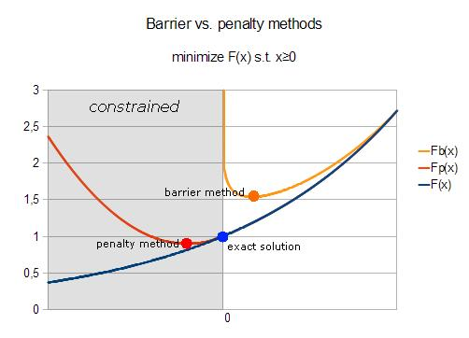
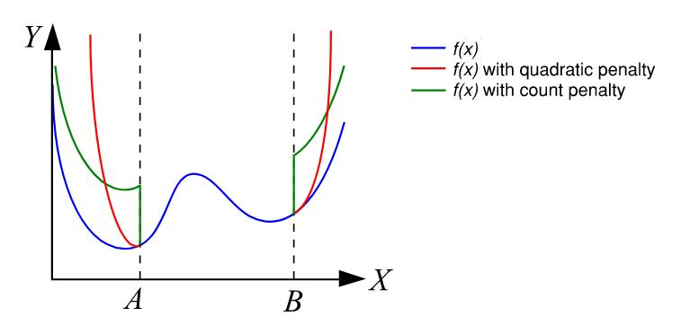
Comparison Table
Method | Formula | Advantage | Limitation | Meaning
Lagrange | f + λh | Exact solution | Needs equality constraint | Balance constraint & objective
Penalty | f + r . P(x) | Converts to unconstrained | Needs Tuning | Punish constraint violation
Quadratic Penalty | f + r h² | Smooth | Needs large r | Smooth punishment
Exact Penalty | f + r h |  |  | Sharp strict punishment

Slide 57
Numerical Solution
1) Lagrange Multiplier Method
Problem -: Minimize : f(x,y) = x² + y² , Subject to : x+y = 4
Solution :
Step 1: Lagrangian : L = x² + y² + λ (x+y−4)
Step 2: Partial derivatives : ∂L/∂x ​= 2x+λ = 0 , ∂L/∂y ​= 2y+λ = 0 , x+y = 4
Step 3: Solve : From first two : 2x =2y ⇒x =y , Substitute: x+x = 4⇒ x =2 & y=2
Final Answer : (x∗, y∗) = (2 ,2)
2) Quadratic Penalty Method
Problem -: Minimize : f(x) = x² , Subject to : x−2 = 0 , Using quadratic penalty with r = 10
Solution :
Penalty function : F(x) = x² + 10 (x−2)²
Step 1: Expand : F(x) = x² + 10 (x² − 4x + 4) , F(x) = x² + 10 x² − 40x + 40 , F(x) = 11x² − 40x + 40
Step 2: Differentiate : dF/dx ​= 22x − 40
Step 3: Set zero : 22 x = 40 , x = 40/22 ​= 1.818
Final Answer : x ≈ 1.818

Slide 58
3) Exact Penalty Method
Problem : Minimize : f(x) = x² , Subject to : x−2 = 0 , Using exact penalty with r = 5
Solution :
Penalty function: F(x) = x² + 5 ∣x−2∣
Case 1: x ≥ 2
F(x) = x² + 5(x−2) , F′(x) = 2x + 5
Set zero : 2x + 5 = 0 ⇒x = −2.5
Not valid (x ≥ 2)
Case 2: x < 2
F(x) = x² + 5(2-x) , F′(x) = 2x - 5
Set zero : 2x - 5 = 0 ⇒x = 2.5
Not valid (x < 2)
Check boundary : x = 2
Final Answer : x∗ = 2

Slide 59
4) Penalty Method (Inequality Constraint)
Problem : Minimize : f(x) = x² , Subject to: x−1 ≤ 0 , Using penalty : F(x) = x² + r . max(0,x−1)²
Solution :
Case 1: x ≤ 1
F(x) = x²
Minimum at : x = 0
Check feasibility : 0 ≤ 1 ⇒ valid
Case 2: x > 1
Penalty added → higher value
Final Answer : x∗ = 0

Slide 60
Practise Problem
1) Lagrange Multiplier Method
Q1 Minimize: f(x,y) = x² + y²+ xy , Subject to: x+y = 3 , Find optimal x, y using Lagrange method.
Q2 Minimize: f(x,y) = x² + 4y² , Subject to: 2x+y= 5 , Solve completely.
Q3 Minimize: f(x,y,z) = x²+ y²+ z² , Subject to: x +y +z = 6 , Find optimal values.
Q4 (Conceptual) Show that at optimum: ∇f = −λ∇h , Explain geometrically.
Q5 Minimize: f(x,y) = x² +y² −4x −6y , Subject to: x²+ y² = 5 , Solve using Lagrange multipliers.
Q6 Minimize: f(x,y) =xy , Subject to: x² + y² =10 , Find minimum and maximum values.
2) Quadratic Penalty Method
Q7 Minimize: f(x) = x² , Subject to: x−3 = 0 , Use quadratic penalty with r = 5
Q8 Minimize: f(x,y) = x² + y² , Subject to: x + y =2 , Write penalty function and find approximate solution for r= 10
Q9 Minimize: f(x) = x² −2x , Subject to: x−1 =0 , Solve using penalty method.
Q10 Minimize: f(x,y) = x² +y² , Subject to: x +2y −4 =0 , Solve using quadratic penalty with r = 50
Q11 Minimize: f(x,y) = x² + y² , Subject to: x² +y² −1 = 0 , Form penalty function and derive equations.

Slide 61
3) Exact Penalty Method
Q12 Minimize: f(x)= x² , Subject to: x−2 = 0 , Use exact penalty with r = 4
Q13 Minimize: f(x) = x²− 4x , Subject to: x−1 = 0 , Solve using exact penalty.
Q14 Minimize: f(x,y) = x² + y² , Subject to: x +y −3 = 0 , Solve using exact penalty (case-wise analysis).
Q15 Minimize: f(x) = x² , Subject to: x ≥ 2 , Use exact penalty: F(x) = x² +r . max(0,2−x) , Solve for r = 5
4) Penalty Method (Inequality Constraint)
Q16 Minimize: f(x,y) = x² + y² , Subject to: x+y ≤ 2 , Use penalty function: F(x,y) = x² + y² +r . max (0, x+y−2)²
Q17 Minimize: f(x,y) = (x−1)² + (y−2)² , Subject to: x+y = 3
Compare:
Lagrange solution
Penalty solution

Slide 62
Week 12’s topics
Barrier function
Barrier function vs penalty function
Convergence result

Slide 63


Barrier Function
Equation (Inequality Constraints) : min f(x) subject to g_{i} (x) ≤ 0
Idea : Instead of penalizing violations, we prevent entering infeasible region by adding a barrier that becomes infinite near the
boundary.
Barrier Function Form : F(x,μ) = f(x) + μ B(x)
Where:
Final Form :
Key Property : Defined only for: g_{i} (x) < 0 , As g_{i} (x) → 0 : , Ln (−g_{i}(x)) → − ∞ ⇒ F(x) → ∞
Conclusion : i) You are inside feasible region , ii) Boundary acts like a wall , iii) You cannot cross it.
Real-Life Example : Safe driving within road lanes ( Road boundaries → constraints , Barrier → prevents crossing )
AI/ML Connection : Used in - ( Interior-point methods , Constrained optimization in ML , Training models with strict constraints )
Barrier Function vs Penalty Function
Penalty Function Equation : F(x,r) = f(x) + r ⋅ P(x)
a) Allows infeasible points
b) Penalizes violations

Slide 64
Barrier Function :
a) Does NOT allow infeasible region
b) Keeps solution strictly inside
i) Barrier (inside only)
ii) Penalty (outside allowed but punished)
Comparison Table
Conclusion : a) Barrier → “Don’t cross the boundary” b) Penalty → “You can cross, but pay a cost”
Real-Life Example : Barrier ( Security system blocks entry ) , Penalty ( Fine for breaking rules )
AI/ML Connection : Barrier → strict constraints (robotics, safety ML) , Penalty → soft constraints (regularization)
Feature | Barrier Function | Penalty Function
Feasible region | Inside only | Inside + outside
Constraint violation | Not allowed | Allowed (penalized)
Parameter | μ→0 | r→ ∞
Behavior | Pushes away from boundary | Pushes toward feasible region

Slide 65

Convergence Results
Barrier Method Convergence : We solve sequence : , with μ→0
Result : x(μ)→x∗ , where x∗ is optimal solution.
Central Path: Sequence of solutions forms: { x (μ) } , called central path.
Penalty Method Convergence : F(x,r) = f(x) + r . P(x) , with: r→∞
Result : x(r) → x∗
Penalty : Ill-conditioned for large r (push from outside ) ; Barrier : Requires feasible start (guide from inside )
Real-Life Example: Barrier - Walking inside room toward door ( Stay inside , Gradually approach boundary)
Penalty - WE start outside ( Pay penalty , Move toward allowed region)
AI/ML Connection : Used in [ Interior point methods (large-scale optimization), Training constrained models ,Reinforcement learning constraints]
Concept | Formula | Key Idea | Meaning
Barrier | f − μ ∑ ln (−g) | Stay inside | Invisible wall
Penalty | f + r P(x) | Penalize violation | Fine for Violation
Convergence | μ → 0 , r→∞ | Reach optimum | Gradual Movement to Optimum

Slide 66
Numerical Method
Barrier Function (Log Barrier)
Problem : Minimize: f(x) = x² , Subject to: x −1 ≤ 0 , Using barrier function with μ = 1
Solution :
Step 1: Constraint form : g (x) = x−1 ≤ 0 , - g (x) = 1 - x > 0
Step 2: Barrier function : F(x) = x² − ln⁡(1−x)
Step 3: Differentiate : dF/dx = 2x + 1/(1−x) ​
Step 4: Set to zero : 2x + 1/(1−x) = 0
Multiply: 2x . (1−x) + 1= 0 , 2x − 2x² + 1= 0 , 2x²− 2x− 1 = 0
Step 5: Solve : x = ( 2 ± sqrt (4+8) ) / 4 , x = ( 2 ± 3.464 ) / 4
Feasible solution: x ≈ − 0.366
Final Answer: x ≈ −0.366
Barrier Function (Different μ)
Problem: Same problem with: μ=0.1
Solution :
Barrier function: F(x) = x² − 0.1 ln⁡(1−x)

Slide 67
Derivative: 2x + 0.1 / (1−x) = 0
Multiply: 2x . (1−x) + 0.1 = 0 , 2x− 2x² + 0.1 = 0 , 2x²− 2x −0.1 = 0
Solve: x = ( 2 ± sqrt (4 + 0.8) ) / 4 , x = ( 2 ± sqrt 4.8 ) / 4 , x ≈ − 0.049
Final Answer : x ≈ − 0.049 ( Closer to true solution x = 0 )
Penalty Method
Problem : Minimize: f(x) = x² , Subject to : x −1 ≤ 0 , Using penalty: F(x) = x² + r . max⁡(0, x−1)²
Solution:
Case 1: x ≤ 1
F(x)=x²
Minimum : x = 0
Case 2: x > 1
Penalty increases value
Final Answer: x∗ = 0

Slide 68
Barrier vs Penalty (Comparison Problem)
Problem: Minimize: f(x) = (x−2)² , Subject to : x ≤ 1
Solution
Barrier Method: F(x) = (x−2)² − μ . ln⁡(1−x)
Solution stays strictly: x < 1
Penalty Method: F(x) = (x−2)² + r . max ⁡(0, x−1)²
Solution may approach boundary from outside.
Conclusion : (Barrier → inside approach , Penalty → outside correction )
Convergence (Barrier Method)
Problem: Given sequence:: μ=1,0.1,0.01 , Solutions: x₁ = −0.36 ,x₂ = −0.049 , x₃ → 0
Solution: As: μ → 0 , x(μ) → 0
Final Answer: Converges to true minimum : x∗ = 0
Convergence (Penalty Method)
Problem: Given: r = 1,10,100 , Solutions: x₁ =1.5, x₂ = 1.1, x₃ → 1
Solution: As: r →∞ , x(r) → 1
Final Answer: Converges to boundary solution.

Slide 69
Practise Problem
Barrier Function
1) Minimize: f(x) = x² , Subject to : x−2 ≤ 0 , Form the log barrier function and find the stationary point for: μ=1
2) Minimize: f(x) = (x−1)² , Subject to: x ≤ 0 , Use barrier function and solve for: μ = 0.5
3) Minimize: f(x,y) = x² + y² , Subject to: x + y −1 ≤ 0 , Form barrier function and write first-order conditions.
4) Show that barrier function is defined only when: g(x) < 0, Explain mathematically.
Barrier Function (Hard)
5) Minimize: f(x,y) = x² + y² , Subject to: x + y − 2 ≤ 0 , Use barrier function: F(x,y) = x² + y² − μ . ln⁡(2 −x −y)
Find stationary equations and solve for μ = 0.1
6) Minimize: f(x) = x² − 2x , Subject to: x ≤ 1 , Solve using barrier function for: μ = 1, 0.1, 0.01 , Analyze how solution changes.
Penalty vs Barrier (Medium)
7) Minimize: f(x) = (x−3)² , Subject to: x ≤ 2 , Write: i) Penalty function ii)Barrier function . Compare both formulations.
8) Explain difference between barrier and penalty methods for: f(x) = x² , Subject to: x ≤ 1 , Show mathematical expressions.
9)True or False (justify): Barrier method can start from infeasible point.
10) Minimize: f(x,y) = x² + y² , Subject to: x + y ≤ 2 , Compare: i) Penalty method solution ,ii)Barrier method solution
Explain behavior graphically.

Slide 70
Convergence
12) Given barrier sequence: , μ = 1, 0.1, 0.01 , Explain how solution approaches optimum.
13) Given penalty sequence: , r = 1, 10, 100 , Explain convergence behavior.
14) Fill in the blank: , Barrier method converges when: , μ → ____
Convergence (Hard)
15) Prove that for barrier function: F(x,μ) = f(x) − μ . ∑ ln ⁡(−g(x)) , solution converges to optimum as: μ→0
16) Show that penalty method may become ill-conditioned as: r → ∞
17) For function: f(x) = x² , Subject to: x ≤ 1
Compare convergence paths for:
Barrier method
Penalty method
Concept + Theory ( Important)
18) Explain central path in barrier method.
19) Explain why barrier method requires feasible starting point.
20) Explain geometrically: Barrier vs Penalty behavior

Slide 71
Week 13
Compactness, characterisation of solution
Duality
Lagrange Dual
Weak duality and Strong Duality(Slater’s Conditions)
Complementary Slackness

Slide 72

Compactness & Characterisation of Solution
Definition A set S ⊂ R^{n} is compact if: i) It is closed (contains boundary points) , ii) It is bounded (finite size)
Importance in Optimization : If : f(x) is continuous , S is compact , Then:
Guarantees existence of optimal solution
Conclusion : a) Compact set = “finite, closed region” , b) Optimization inside it always has a solution
Characterisation of Solution : A point x∗ is optimal if:
Unconstrained: ∇ f(x∗) = 0
Constrained (KKT): ∇ f(x∗) + ∑ λ_{i} ∇ g_{i} (x∗ ) = 0
Geometric condition: ∇ f(x∗)^{T} d ≥ 0 ,for all feasible directions d
Meaning: i) No direction improves solution, ii)Gradient is “blocked” by constraints
Real-Life Example: Budget shopping issue( Budget limits → bounded, All options considered → closed ,Best purchase always exists.)
AI/ML Connection: Parameter constraints in ML , Ensures loss minimization is achievable , Used in regularized optimization.
Characterisation of Solution
Point x∗ is optimal if: Unconstrained: ∇f (x∗) = 0 ; Constrained (KKT): ∇f (x∗) + ∑ λ_{i} ​∇g_{i​} (x∗) = 0 ; Geometric condition: ∇f (x∗)^{T} d ≥ 0 , ( for all feasible directions d )
Meaning : i) No direction improves solution , ii) Gradient is “blocked” by constraints

Slide 73



Duality
Aim : Every optimization problem (primal) has a corresponding dual problem.
Primal Problem: min ⁡f(x) , subject to g_{i} (x) ≤ 0
Dual Problem: max⁡ θ (λ) , where: θ(λ) = inf⁡_{x} L (x,λ)
Key Insight: i) Primal → original problem , ii) Dual → transformed problem , iii) Solving dual can be easier
Real-Life Example : Company production problem ( Primal → minimize cost , Dual → maximize profit from resource pricing )
AI/ML Connection: Used in: ( SVM , Lagrangian optimization , Deep learning constraints )
Lagrange Dual
Lagrangian :-
Dual Function :-
Dual Problem :-
Key Property :- θ (λ) ≤ f ( x∗ ) , (always gives lower bound)
Idea :- i) Fix λ, minimize over x , ii) Then maximize over λ
Real-Life Example :- Resource allocation ( Assign “price” to constraints , Optimize system using prices )
AI/ML Connection :- Used in - SVM dual formulation , Convex optimization , Regularized learning
Weak Duality
Statement : For any feasible x and λ: θ (λ) ≤ f (x)
Meaning : Dual solution is always a lower bound of primal.
Idea : i) Dual never overestimates primal , ii) Safe approximation

Slide 74
Real-Life Example :- Estimated cost is always ≤ actual cost.
AI/ML Connection :- Ensures stability in optimization , Used in loss bounds
Strong Duality
Statement : min f(x) = max θ(λ)
Condition : when - i) Problem is convex , ii) Slater’s condition satisfied
Slater’s Condition
Statement : If there exists x such that : g_{i} ​(x) < 0 , (strict feasibility)
So : Strong duality holds.
Idea : i) There is a point strictly inside feasible region , ii) No boundary issues
Real-Life Example : Room with space inside (not just boundary) - We can move freely , Optimization behaves properly.
AI/ML Connection : Used in i) SVM optimality , ii) Convex ML problems , iii) Efficient training

Slide 75
Table
Concept | Key Idea | Meaning | Formula
Compactness | Solution exists | Finite region → solution exists | Closed + bounded
Characterization | Optimality condition | —- | ∇f = 0
Duality | Two problems | Two views of same problem | Primal ↔ Dual
Lagrange Dual | Transform problem | Solving via multipliers | max θ (λ)
Weak Duality | Lower bound | Lower bound | θ ≤ f
Strong Duality | Equal solutions | Exact match | f = θ
Slater Condition | Feasibility | Guarantees strong duality | g(x) < 0

Slide 76
Numerical Method
1) Compactness & Existence of Solution
Problem : Minimize: f(x) = x² − 4x , over range S = [ 0,3 ]
Solution
Step 1: Check compactness : Interval [0,3] is - closed , bounded . So Compact SET.
Step 2: Check continuity : f(x) is continuous.
Step 3: Conclusion : By Weierstrass theorem: ∃ x∗ ∈ S
Step 4: Find minimum : f′(x) = 2x − 4 , 2x −4 = 0 ⇒ x = 2 , Checking : f(0) = 0, f(2) =−4 , f(3) = 3
Final Answer : x∗ = 2, f(x∗) = −4
2) Characterisation of Solution
Problem : Minimize : f(x,y) = x² + y² , subject to : x +y = 2
Solution
Step 1: Lagrangian : L = x² + y² + λ (x+y−2)
Step 2: Stationarity : 2x +λ = 0 , 2y +λ = 0
Step 3: Solve : x = y , x + y = 2 ⇒x =1, y =1
Final Answer : (x∗, y∗) = (1, 1)

Slide 77
3) Lagrange Dual Problem
Problem : min f(x) = x² , Subject to : x − 1 ≥ 0
Solution
Step 1: Rewrite constraint : g(x) = 1 − x ≤ 0
Step 2: Lagrangian : L(x,λ) = x² + λ ( 1−x )
Step 3: Dual function : Minimize w.r.t x: dL/dx ​= 2x − λ = 0 , x = λ/2​
Step 4: Substitute : θ(λ) = (λ​/2)² + λ( 1 − λ/2 ​) , θ(λ) = λ^{2​} /4 + λ − λ^{2​} /2 = λ − λ^{2​} /4
Step 5: Maximize : dθ/ dλ ​= 1 − λ/2​ = 0 , => λ = 2
Step 6: Dual value : θ(2) = 2−1 = 1
Final Answer : Dual optimum = 1
4) Weak Duality
Problem : Given : f(x) = x² , x = 2 , Dual function: θ(λ) = λ − λ²​ /4 , Take λ = 1
Solution
For : f(2) = 4 , Dual value : θ(1) = 1 −1/4 ​= 0.75
Check : θ(λ) ≤ f(x) , 0.75 ≤ 4
Final Answer : Verified (Weak duality holds.)

Slide 78
5) Strong Duality (Slater’s Condition)
Problem : Minimize: f(x) = x² , Subject to: x > 0.
Solution
Step 1: Slater’s condition : There exists x such that: x > 0 , Example: x= 1
Step 2: Convexity : f(x) = x² is convex
Step 3: Conclusion : Strong duality holds
Final Answer : Dual optimum
6)Complementary Slackness
Problem : Minimize: f(x) = x² , Subject to: x − 1 ≥ 0
Solution
Step 1: Constraint : g(x) = 1− x ≤ 0
Step 2: Optimal solution : x∗ = 1
Step 3: Complementary slackness : λ (1− x∗) = 0 , λ(0) = 0
Step 4: Status of λ , λ = 2
Final Answer : Condition satisfied

Slide 79
7) Complementary Slackness (Inactive Constraint)
Problem : Minimize: f(x) = x² , Subject to : x ≥ −1
Solution
Minimum of x² : x∗ = 0
Constraint : 0 > −1 ⇒ inactive
Complementary slackness : λg (x∗) = 0 , λ(−1) = 0 ⇒ λ = 0
Final Answer : λ = 0

Slide 80
Practise Questions
Compactness & Characterisation (Medium & Hard)
1) Determine whether the set is compact: S = { x ∈ R ∣ 0 < x ≤ 2 } , Justify your answer.
2) Minimize: f(x) = x² − 6x + 5 , over the range : S = [ 0, 5 ] , Check existence and find optimal solution.
3) Minimize: f(x,y) = x² + y² − 2x , subject to : x + y = 3 , Use optimality conditions to solve.
4) State and verify the first-order optimality condition for: f(x,y) = x² + y² , at point (0, 0) .
5) Determine whether minimum exists for: f(x) = x² , over range : S = (0,2) , Explain using compactness.
6) Minimize: f(x,y) = x² + y² , Subject to: x² + y² ≤ 4 , Identify optimal solution and justify geometrically.
Duality & Lagrange Dual (Medium & Hard)
7) Form the Lagrangian dual of: min x² , subject to : x ≥ 2
8) Given: L(x,λ) = x² + λ (2−x) , Derive the dual function θ(λ)
9) Find dual problem for: min x² + y² , subject to : x + y =1
10) Given : min x² + y² , subject to : x+y ≥ 1 , Derive dual problem and solve it.
11) Prove that dual function: θ(λ) , is always concave (even if primal is not convex).
Weak & Strong Duality
12) Verify weak duality for: f(x) = x², x = 2 ; θ(λ) = λ− λ² /4 , for λ=1

Slide 81
13) Check whether strong duality holds for: min x² , subject to : x > 0
14) State Slater’s condition and verify it for: f ( x ) = x² , g(x) = x−1 ≤ 0
15) Show that if Slater’s condition holds, then: min f(x) = max θ(λ) , Provide proof outline.
16) Give an example where: Strong duality fails , Explain why
Complementary Slackness
17) Check complementary slackness for: x∗ = 1, g(x) = 1−x ≤0
18) Given: λ = 3, g(x∗) = 0 , Verify condition.
19) Solve using KKT and verify complementary slackness: min x² , subject to : x ≥ 1
20) Minimize: f(x,y) = x² + y² , subject to : x+y ≥ 2 , Solve and verify complementary slackness.

